Slide 1

Marimba
Stay tuned..
Project Definition
Team Members:
Naama Arkin, Tomer Morad, Tommy Irmia

Slide 2
Highlights
Product Name: Marimba
Product Short Description:
Listen to playlists and tracks, create a custom made playlist, share and discover your favorite music, and share your own music as an artist.
Users:
Users, Artists? , (Admin – will not be implemented)
Key features:
Listen to music and premade playlists by other users , create and share playlists, get new music recommendations, share and upload music.
Guest mode:
Guest can see music and playlists previews. Need to login in order to listen and create playlists.

Slide 3
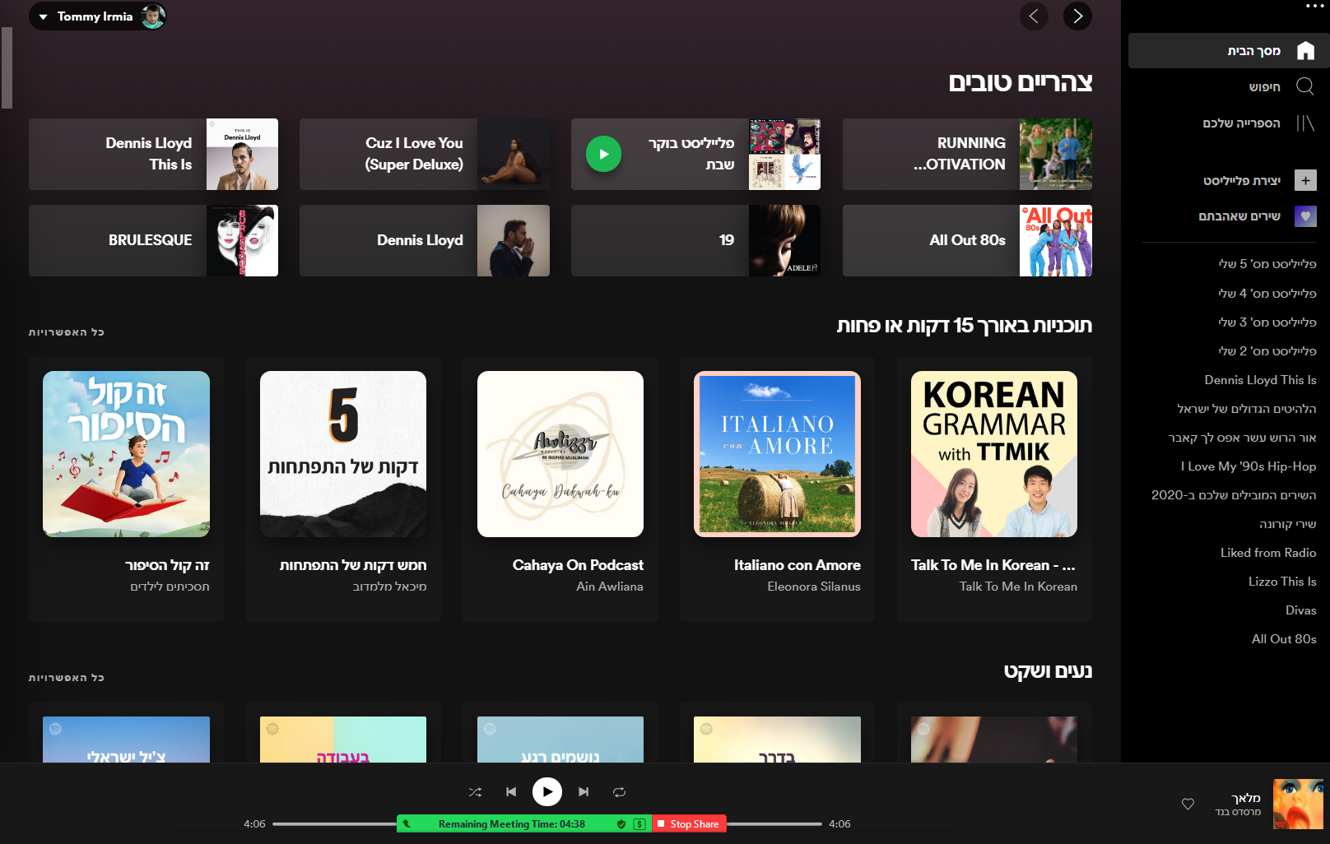
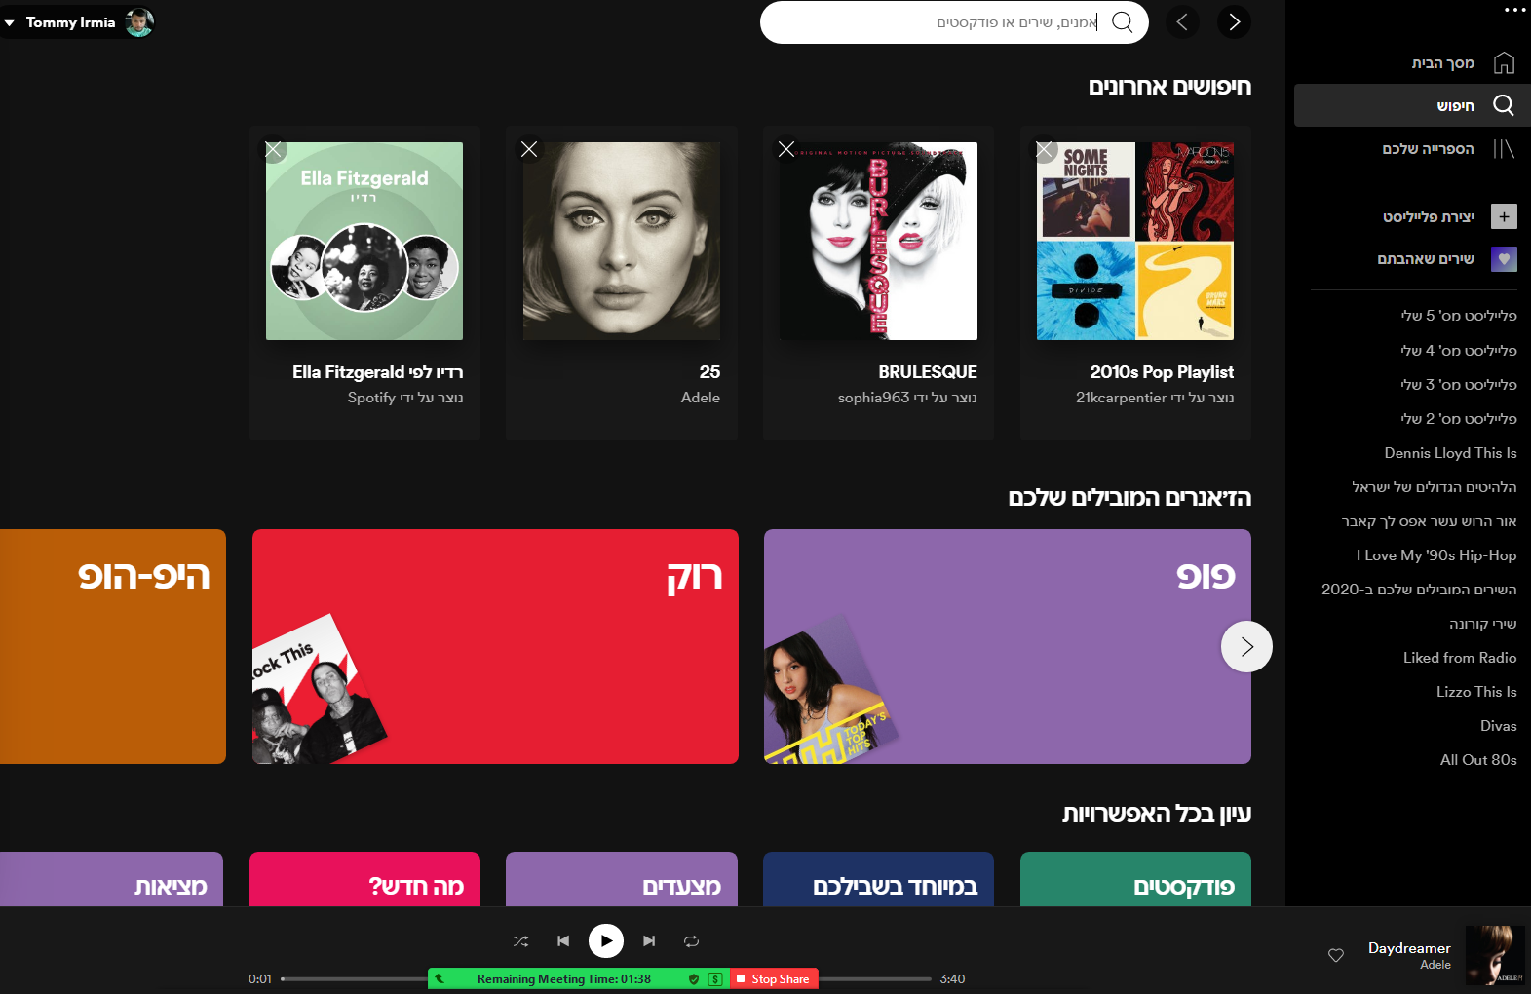
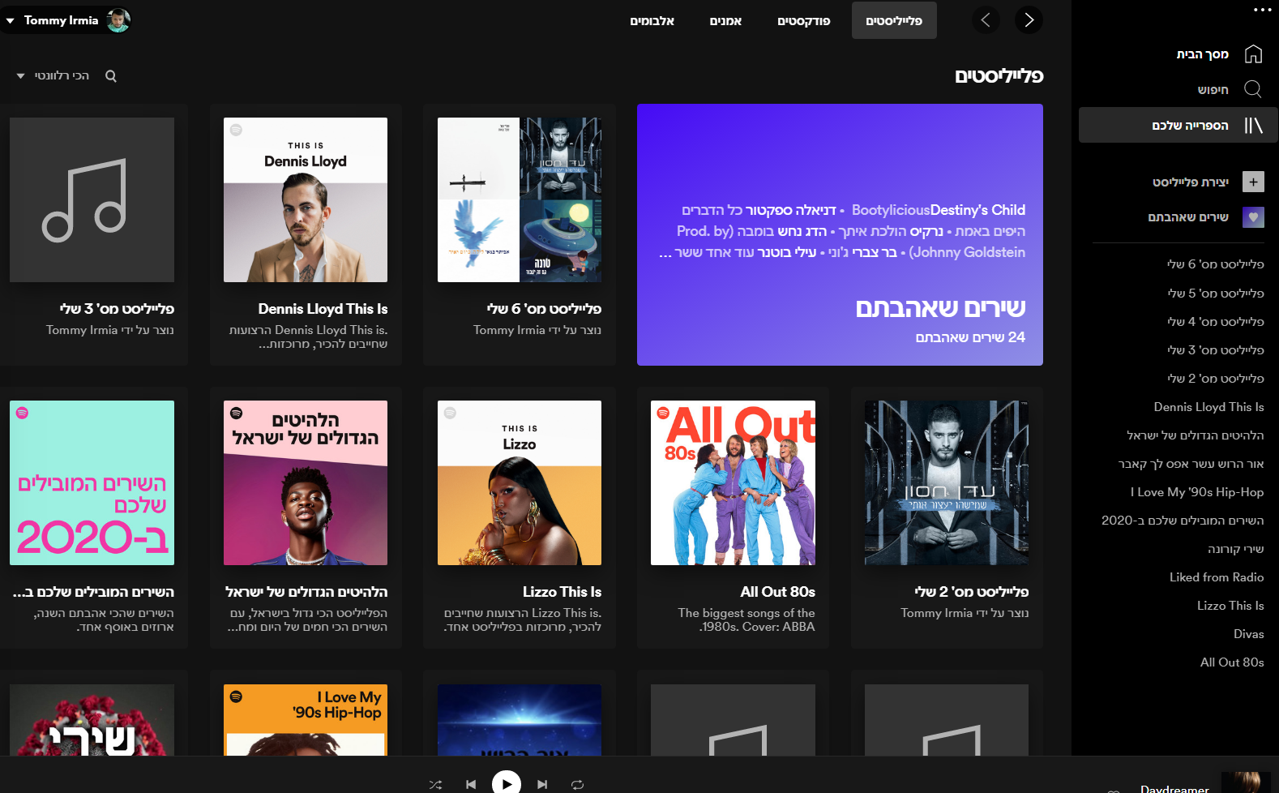
Main Pages / UI Components
Home page
Quick access to most visited playlists, new playlist suggestions, popular artists and music, playlists by genre. (Home page to unlogged in user with HERO)
Search Page (Playlists Preview list)
See all playlists, search / filter by artists, songs & playlist.
My Library Page
Playlists created by the user, custom made playlists created by the app, songs the user liked.
Playlist Page
Login/Signup
Create Playlist
Profile management
User/Artist Page

Slide 4
Main Flows

Slide 5
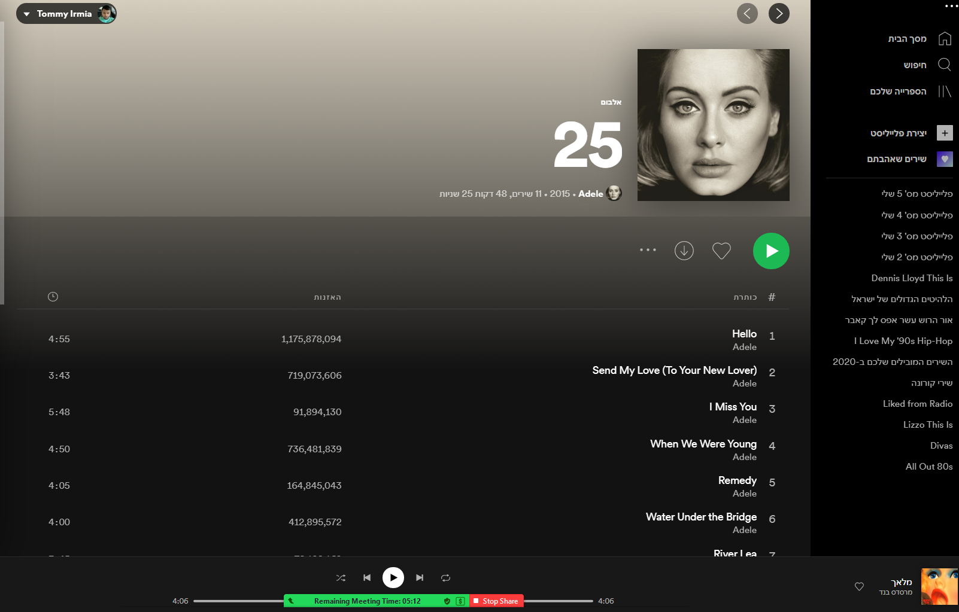
Main Flow 1
Home Page
Clicking on: any one of the playlists previews will redirect you to the specific playlist.
Clicking on: either of the “Play” buttons, starts playing the music.

Slide 6
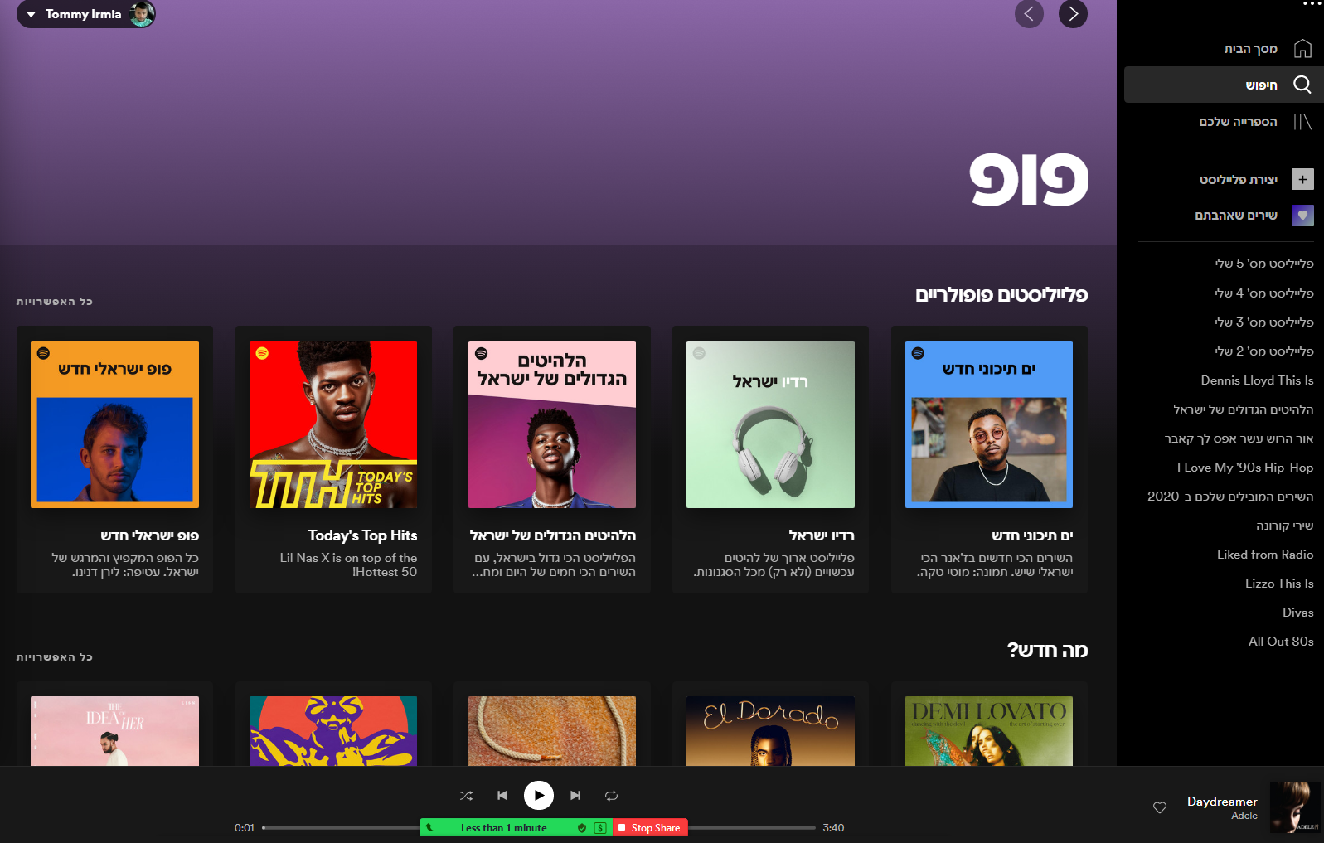
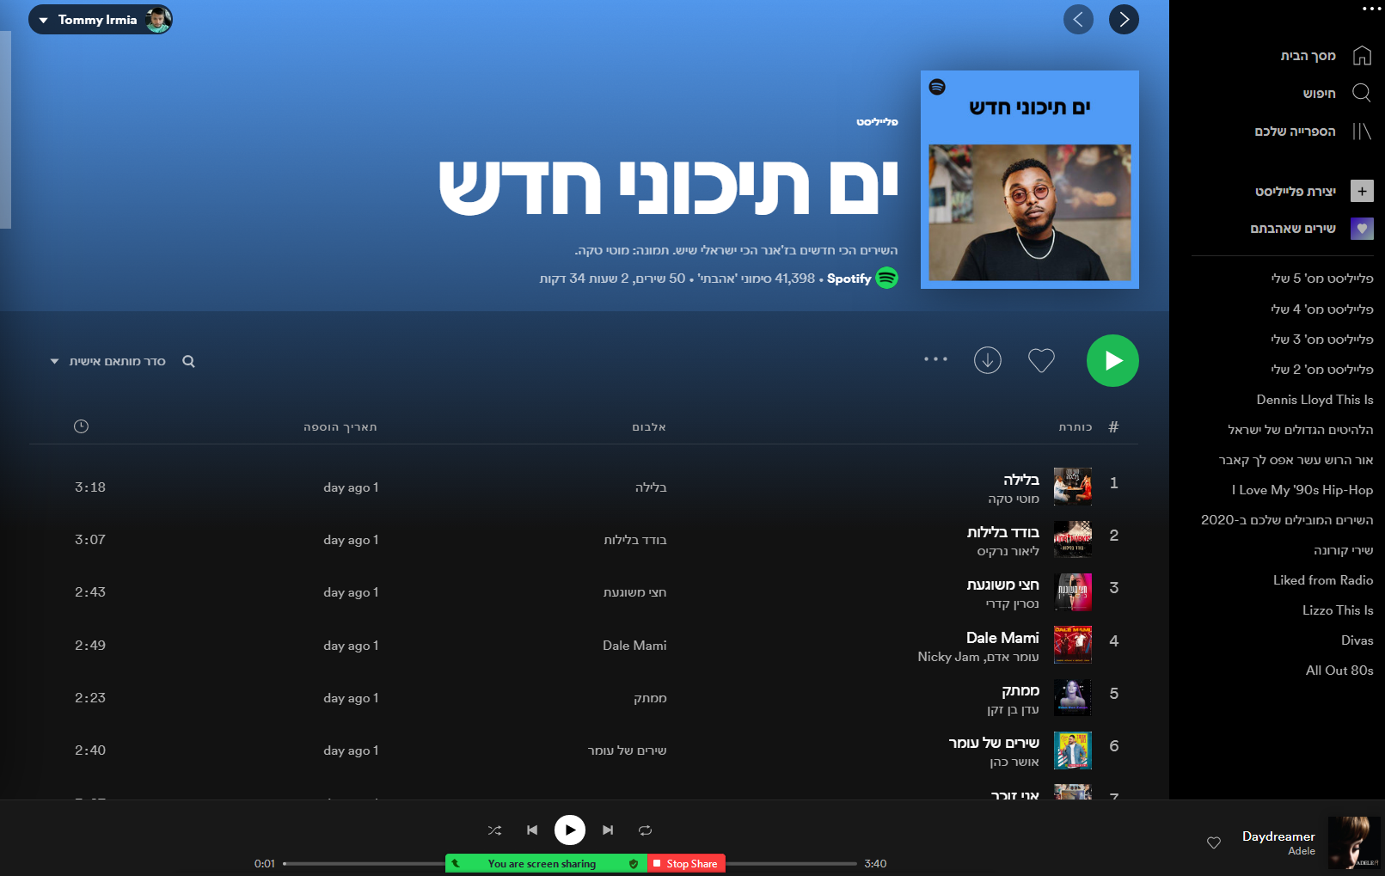
Main Flow 2
Search Page
Typing in the search row or clicking on one of the suggested genres preview – Lead to search result page
Clicking on: either of the playlists suggested will redirect to the playlist page.
Clicking on: either of the “Play” buttons, starts playing the music.

Slide 7
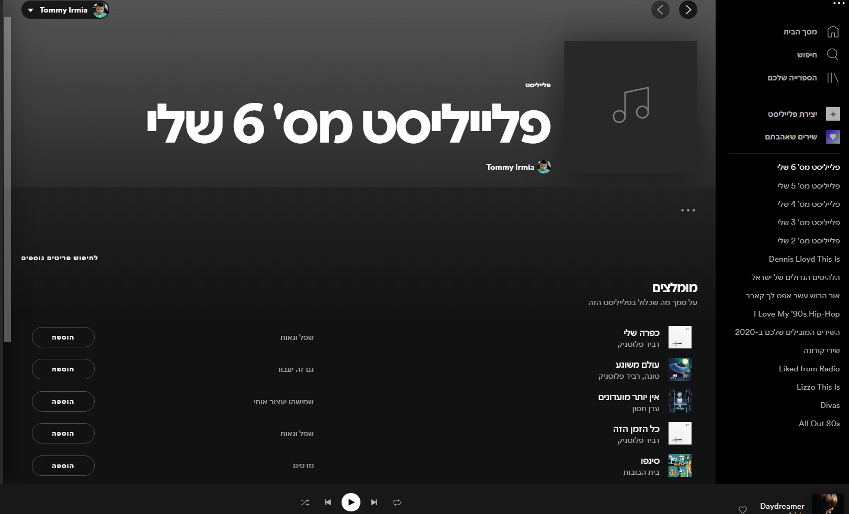
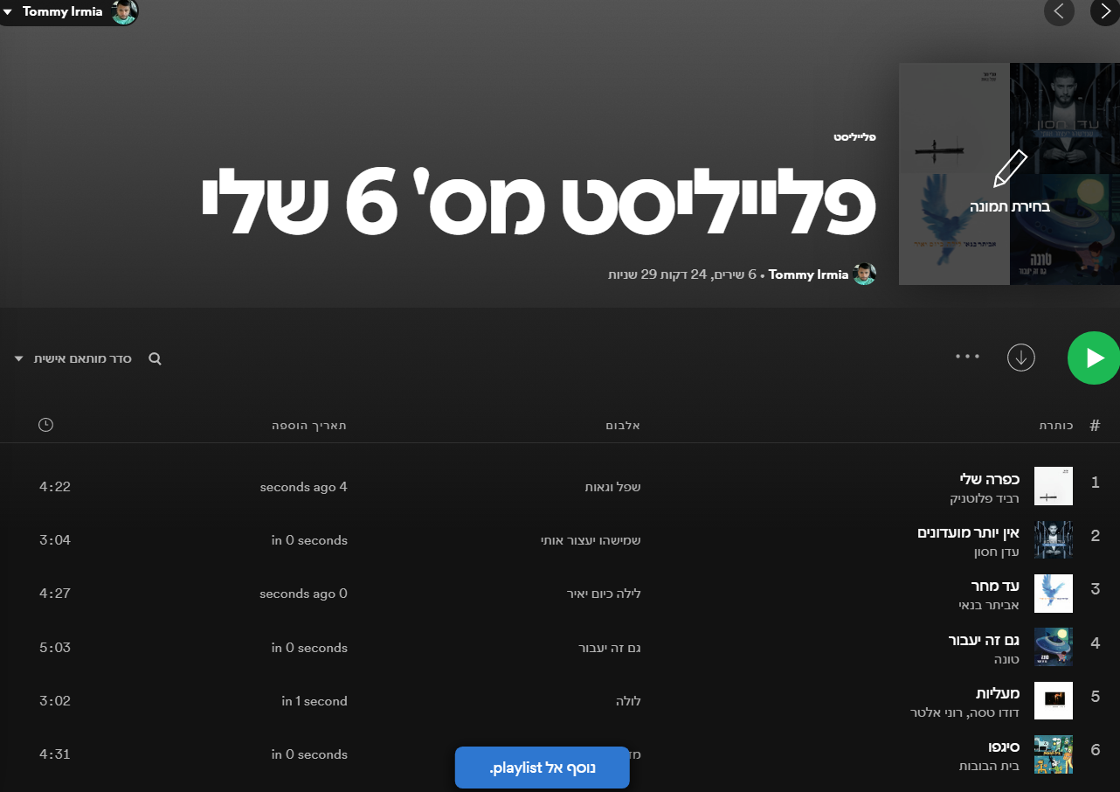
Main Flow 3
Create playlist
Clicking on: “Create Playlist” leads to create playlist page.
You can either search for specific songs & artists, or add into the playlist from the suggested songs.

Slide 8
Main Pages UX

Slide 9
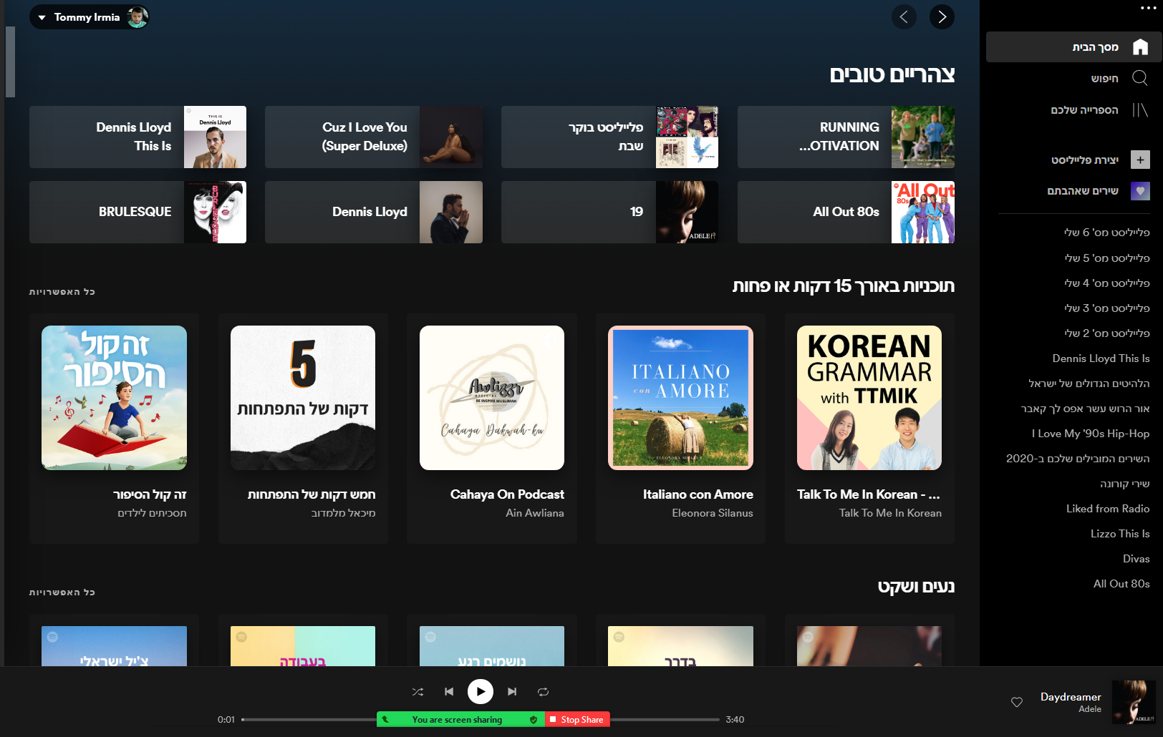
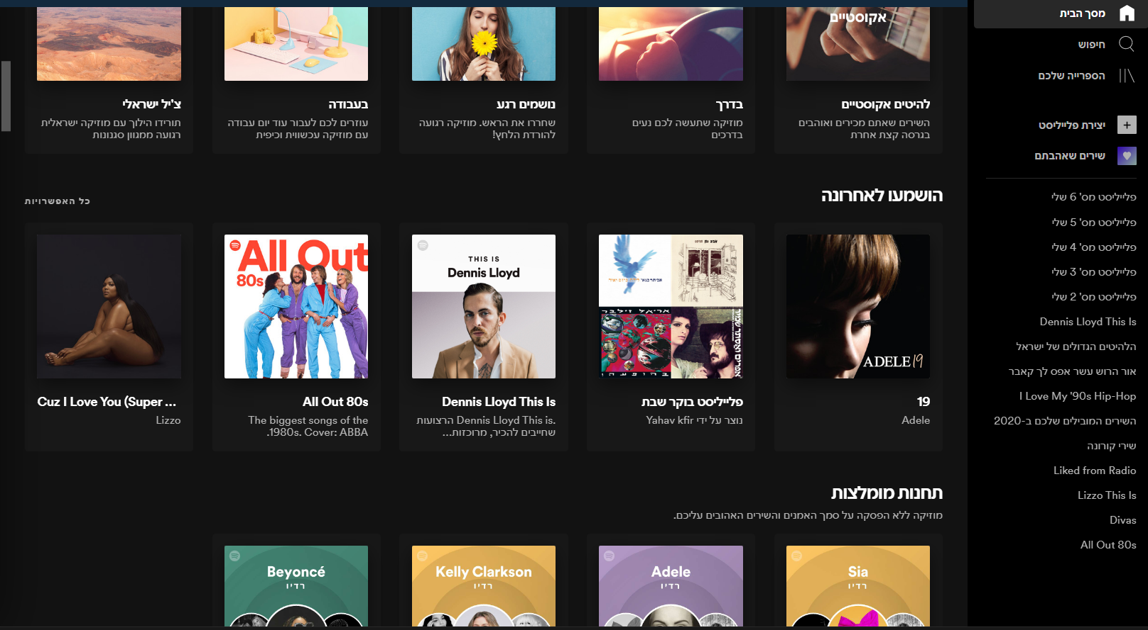
Home Page – Top Fold, Below Fold
Static nav bar
User profile
Main Suggestions : Based on your most visited or most recently visited playlists
Top fold
List of recommendations: Based on your typical music taste or promoting new artists.

Slide 10
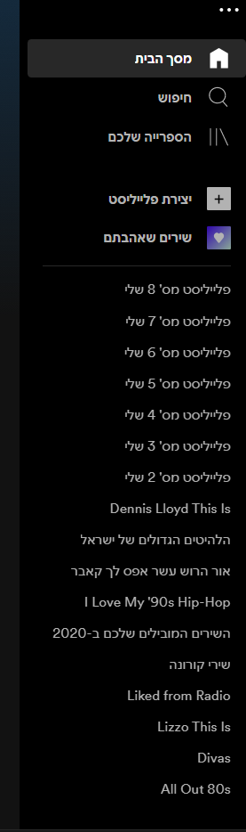
Nav Bar - static
Main pages navigation
Create Playlist
Liked songs
LOGO
Home | Explore | Become Host | Tom
Playlists and more…..

Slide 11
Media Player – bottom screen - static
Media played control buttons
Current played song title and artist
Volume controller, Casting to other devices, expand media player to full screen.
Like button : liking a song automatically
Adding it to the liked song playlist

Slide 12
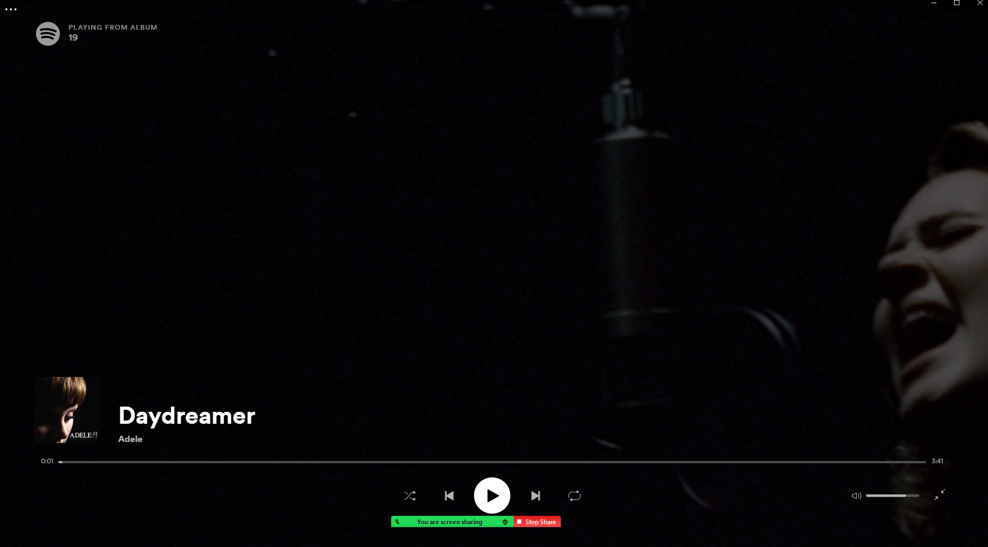
Media Player Expanded
LOGO
Media played control buttons

Slide 13
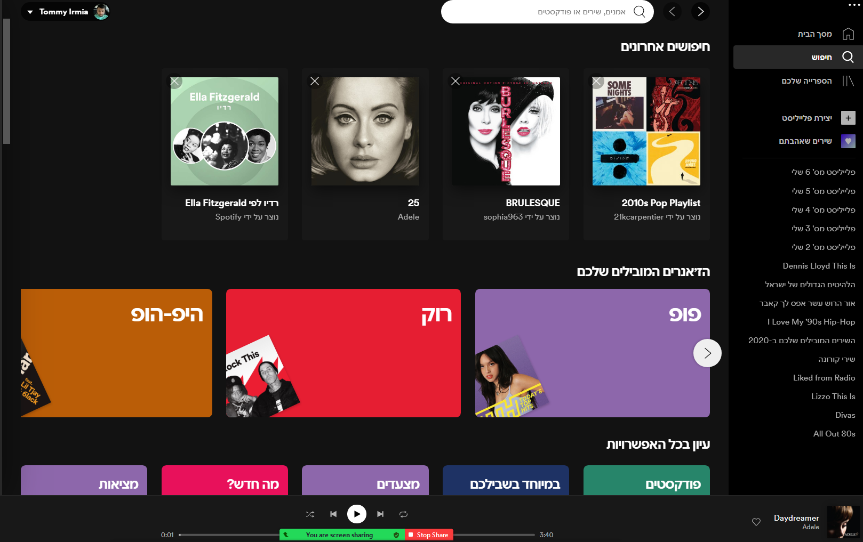
Search Page
Home| Explore | Become Host | Login
Search bar
Recent searches
Search by leading genres
Search by all genres

Slide 14
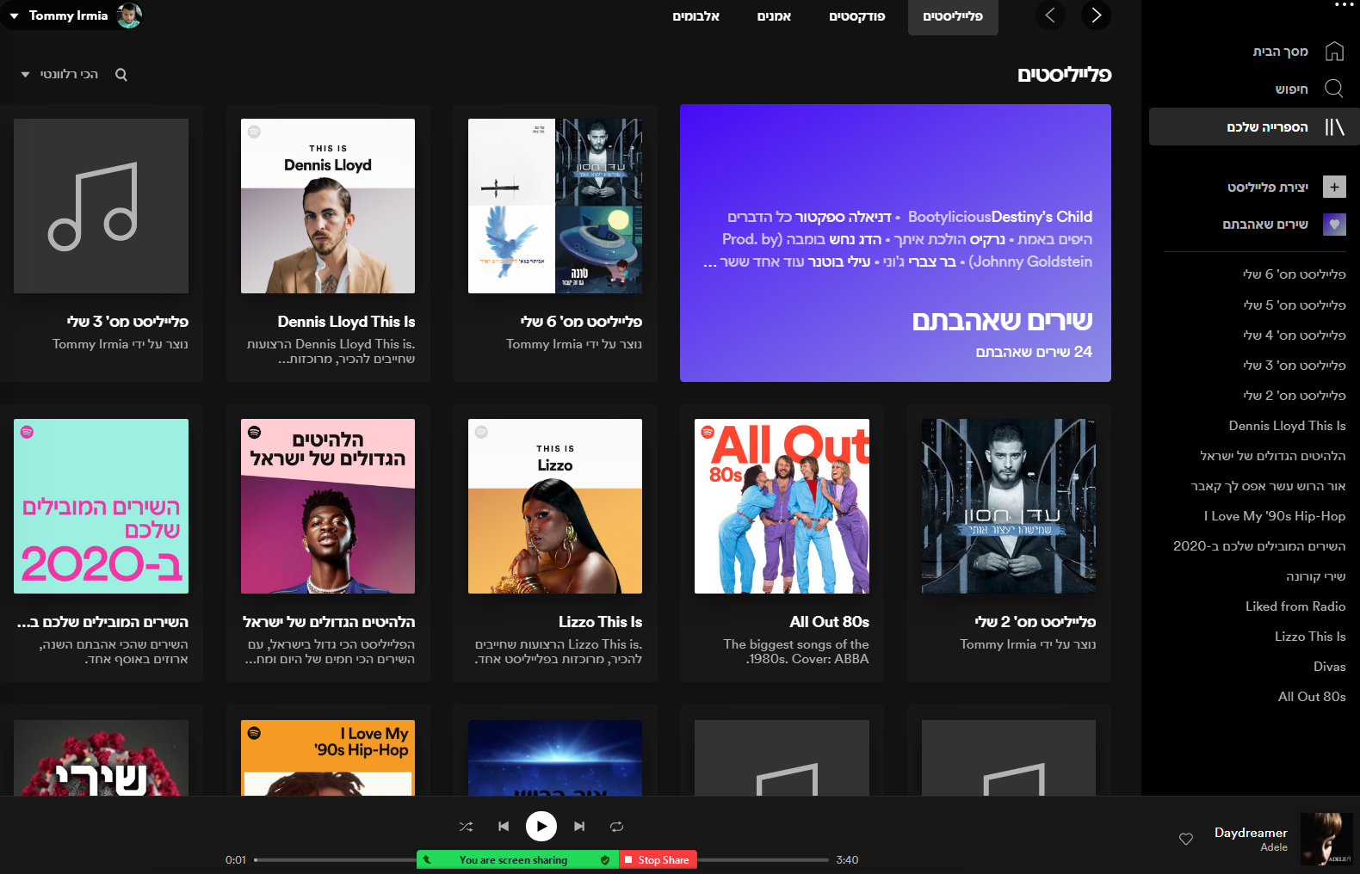
My Library Page
Sort by recently played, relevancy…
Filter by playlist, podcasts…
Playlist of liked songs
Playlist built by user
Custom playlist delivered by app
Custom playlist built by artists

Slide 15
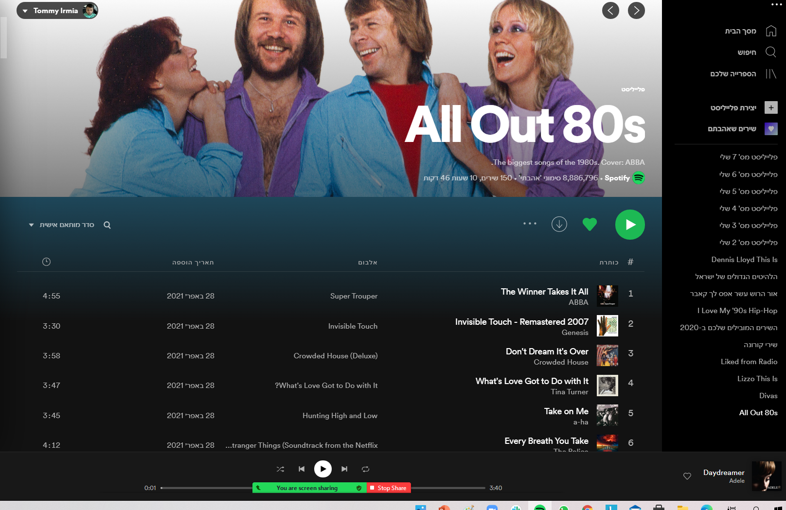
Stay Page Top
Page hero – including photo, title and info
Play button
Sort by recently played, relevancy…
Songs list
Like and download the entire playlist, and additional settings

Slide 16
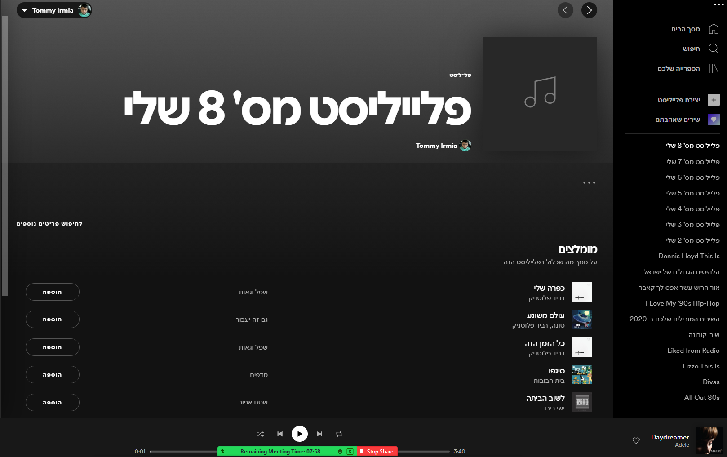
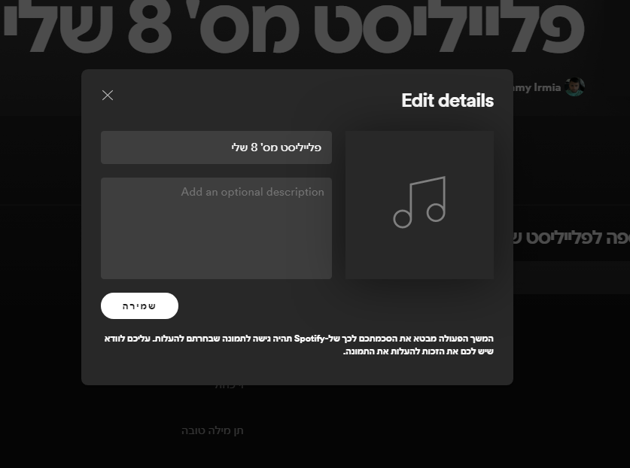
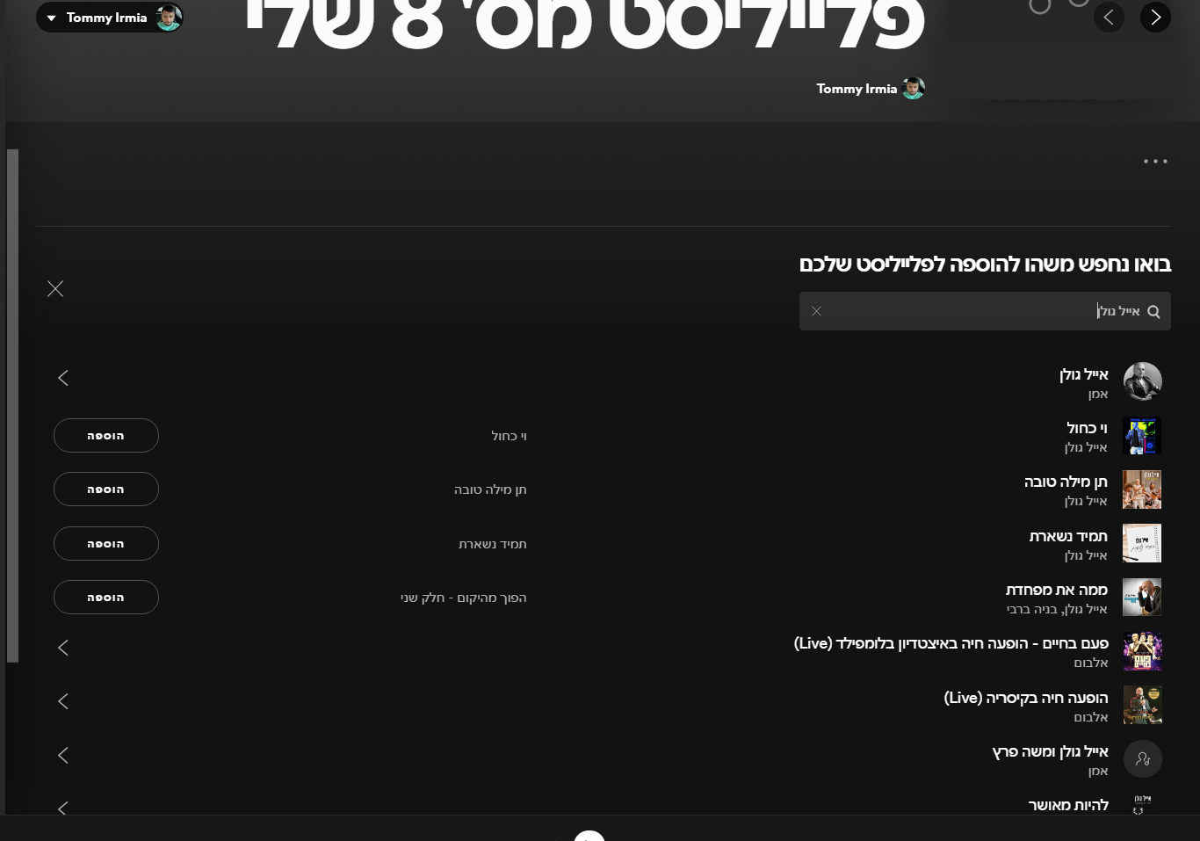
Create playlist page
LOGO
Page hero : including title, user name, and image (can be added by user)
Edit playlist details – opened by clicking on the page hero
Add button
Adding songs list : by search
Adding songs list : by recommendation
Adding songs list : by search

Slide 17
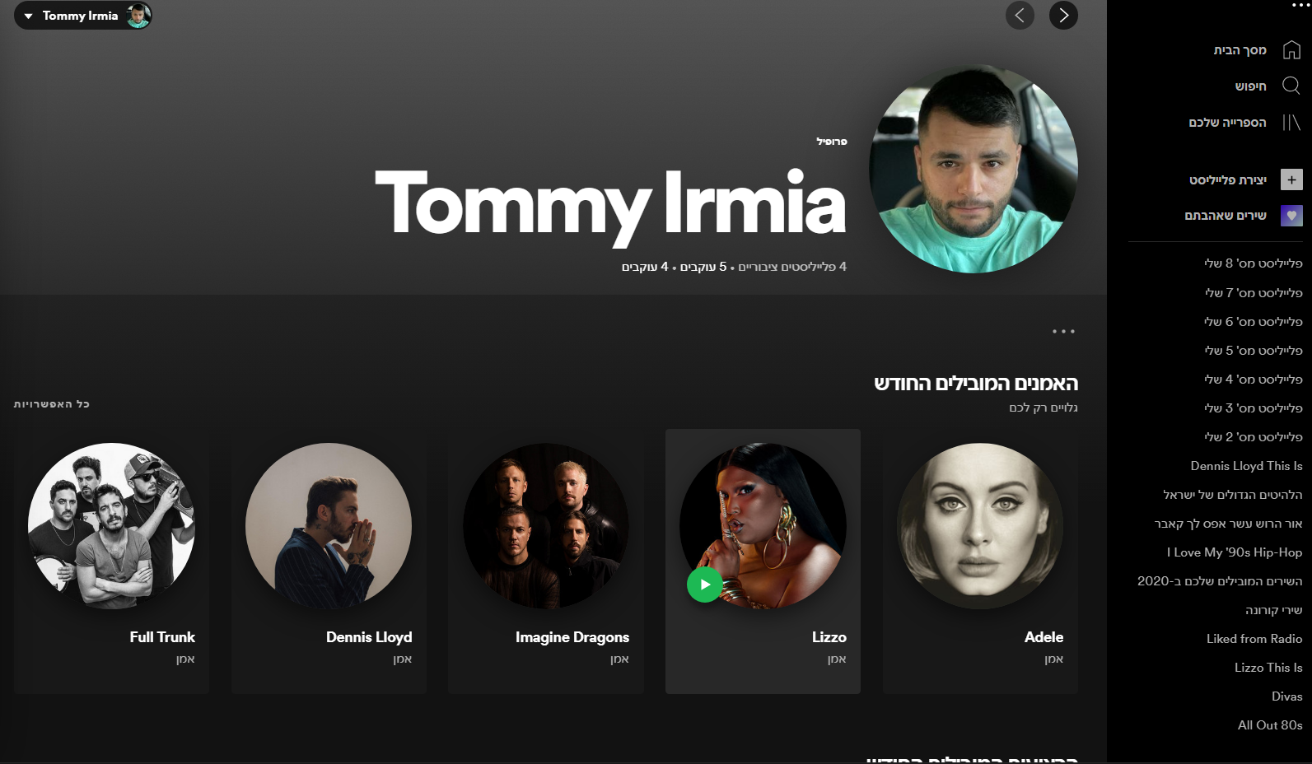
User Profile Page – top fold
LOGO
Home| Explore | Become Host | Anna
Page hero : including user image, name and info (can be edited)
Lead artists preview

Slide 18
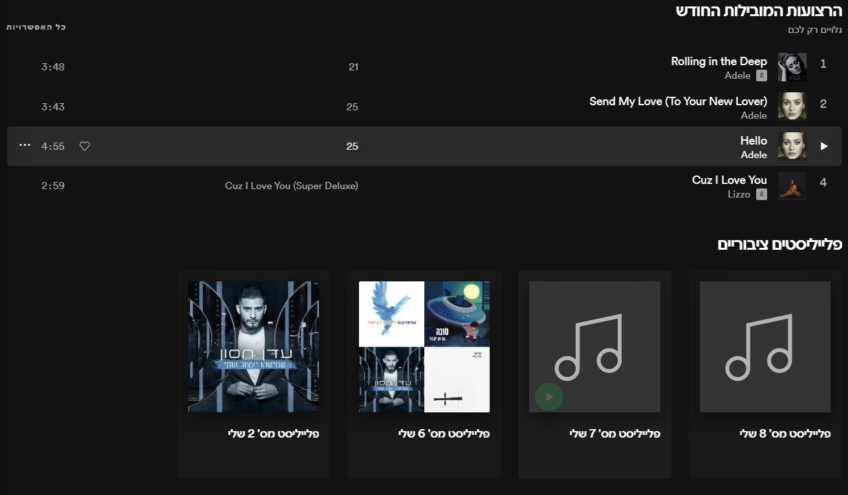
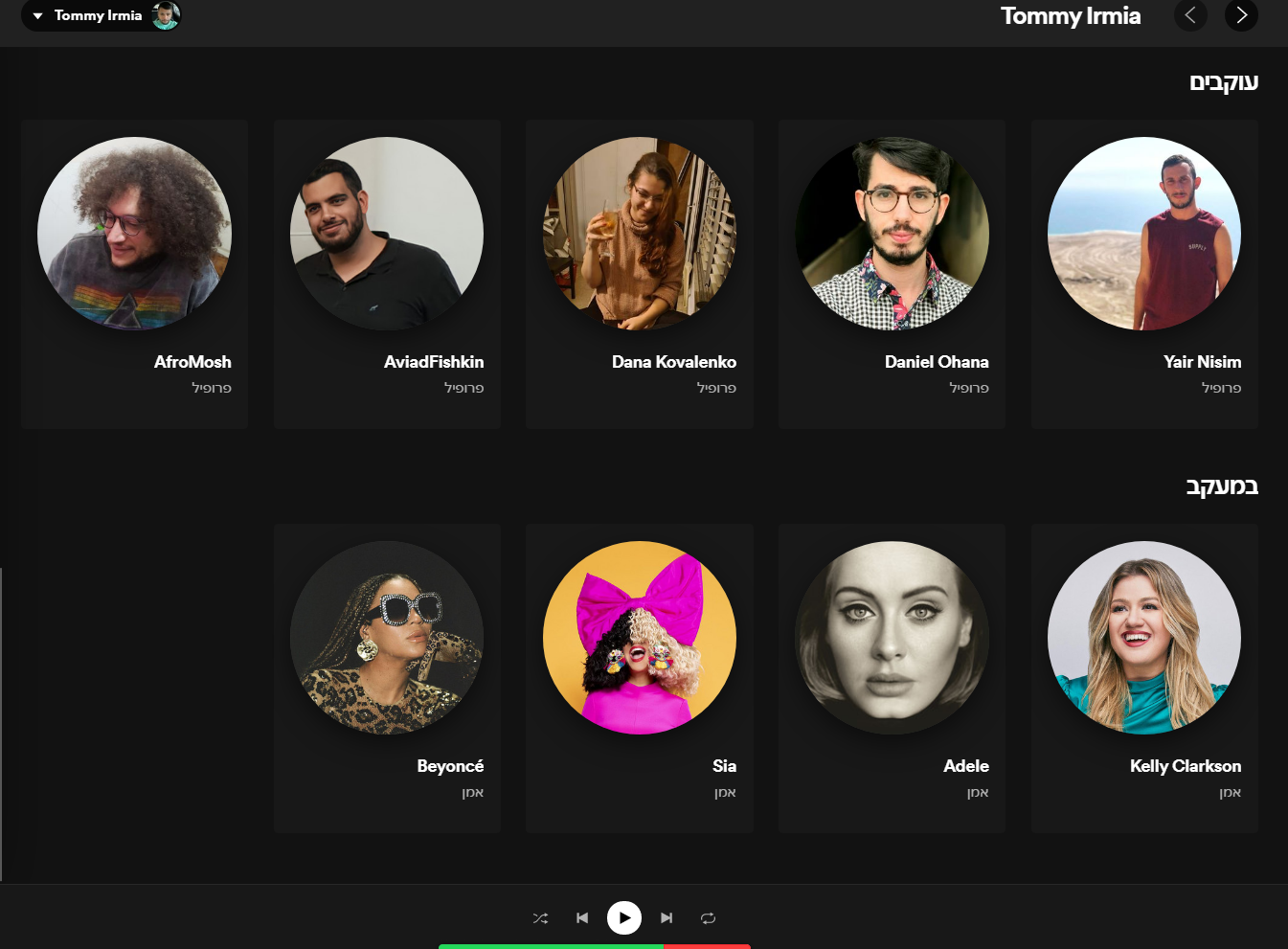
User Profile Page – bottom fold
LOGO
Home| Explore | Become Host | Anna
Leading tracks list
Public playlist created by user preview
Followers
Following

Slide 19
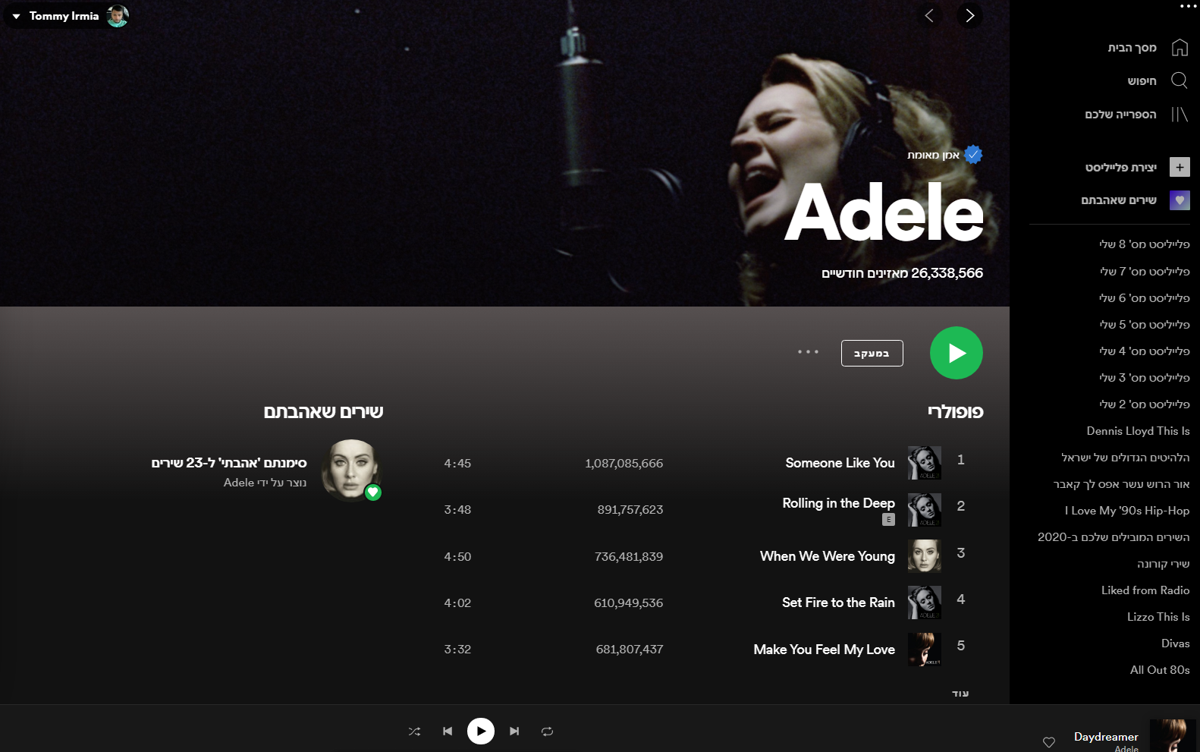
Artist Profile Page – top fold
LOGO
Home| Explore | Become Host | Anna
Page hero : including artist name, image and number of monthly listeners
Liked songs of the artist by the user
Play most popular tracks
List of most popular tracks

Slide 20
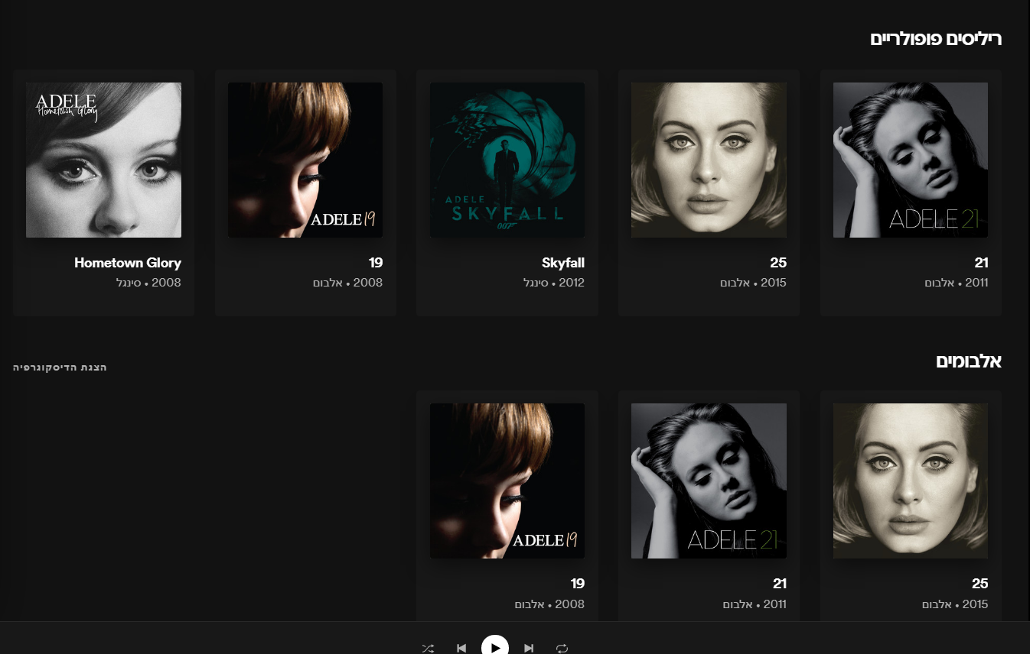
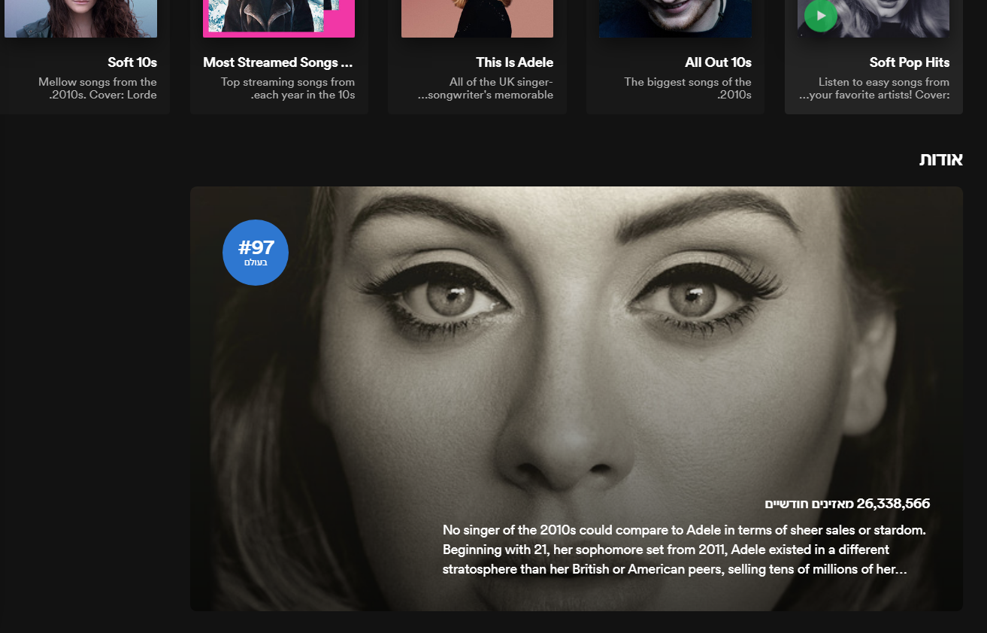
Artist Profile Page – bottom fold
Home| Explore | Become Host | Anna
Popular releases
Albums by the artist
And more….
About the artist

Slide 21
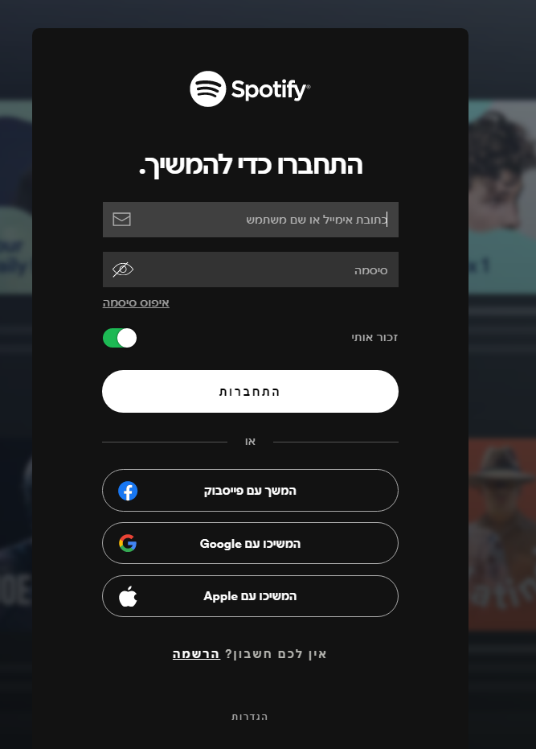
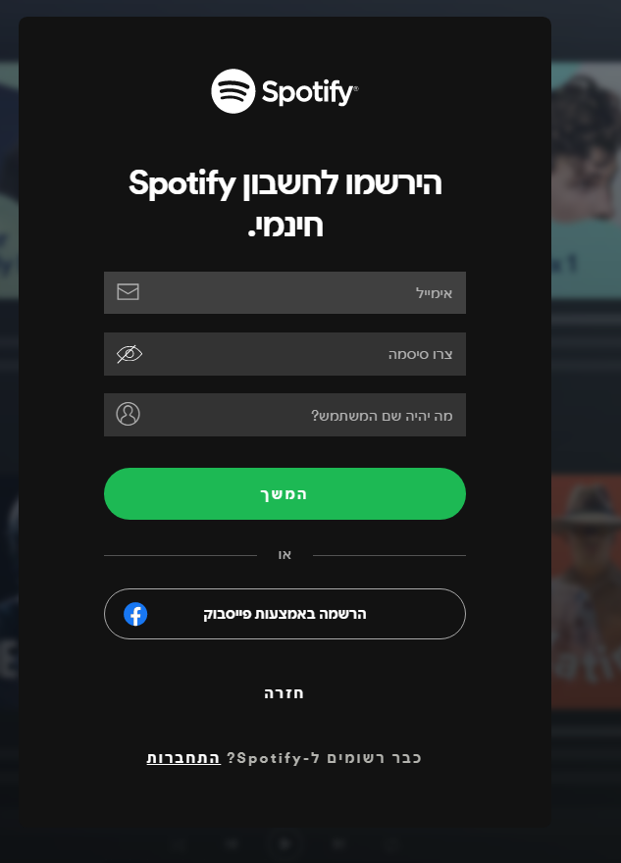
Login Page Signup Page
LOGO
Home| Explore | Become Host | Login

Slide 22
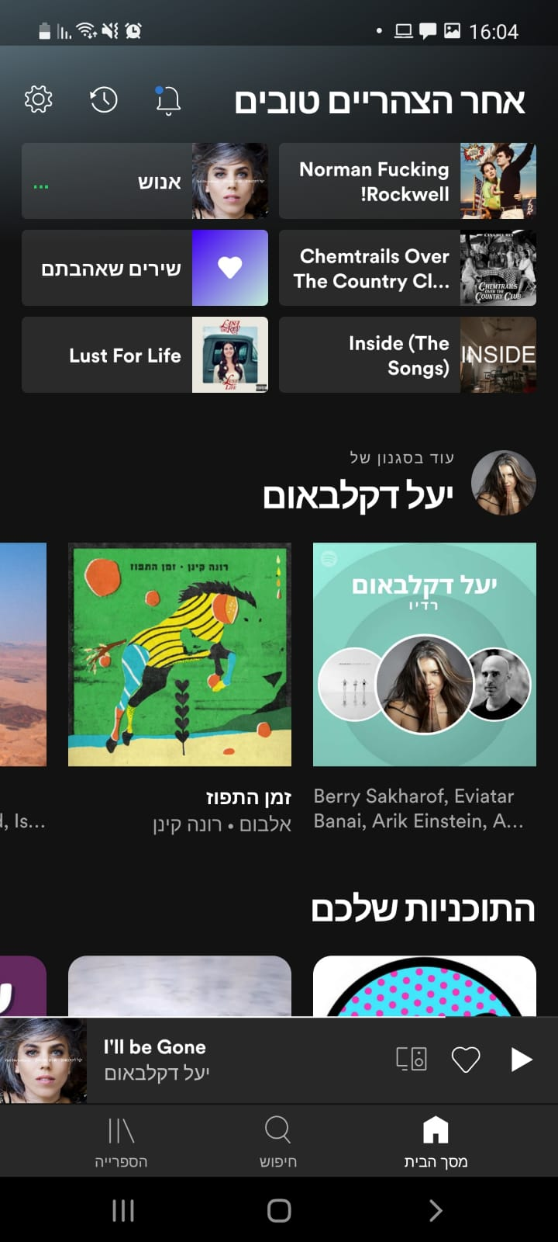
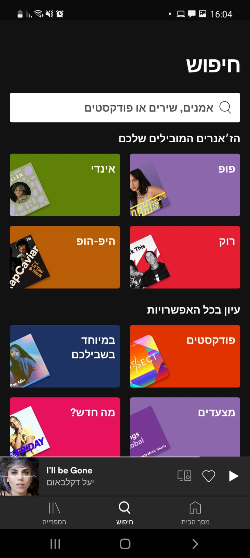
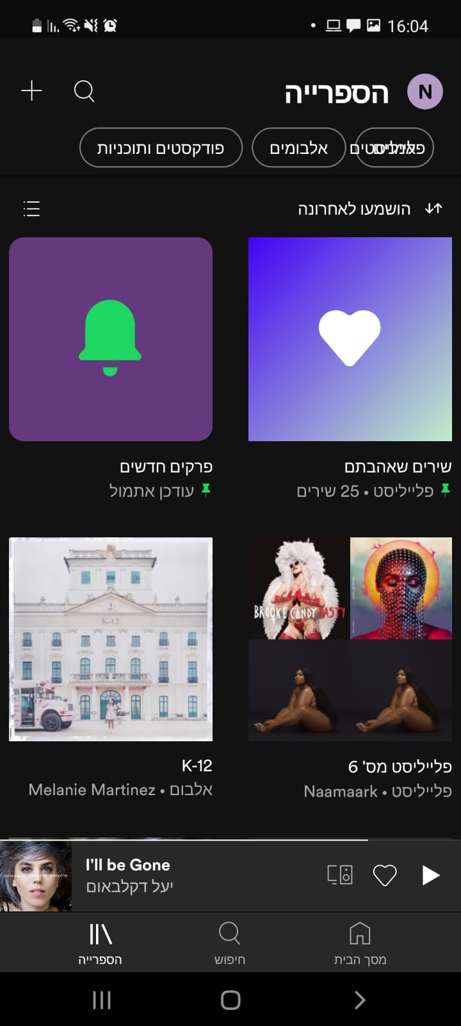
Main pages - mobile view
Home Page
Search Page
My Library Page

Slide 23
GUEST Mode
User is asked to login when: Trying to play a track, create a playlist, clicking on the nav-bar options or liking a song.
How Guests appear:
“Guest”
Additional nav-bar with login/signup buttons.

Slide 24
Special Functionality for Demo
No special functionality

Slide 25

Technical Design

Slide 26
Data Model
Prepare your db.json File

Slide 27
User
{
"_id": "u101",
"fullName": "Orly Amdadi",
"userName": "orly@amdadi.com",
"password": "tinkerbell",
"isAdmin": true,
"imgUrl": "http://some-img"
}

Slide 28
Minimal User (saved in other entities)
{
"_id": "u101",
"fullName": "Orly Amdadi",
"imgUrl": "http://some-img"
}

Slide 29
Stay
{
"_id": "10006546",
"name": "Ribeira Charming Duplex",
"imgUrls": [“mainImg.jpg", "otherImg.jpg"],
"price": 80.00,
"summary": "Fantastic duplex apartment with three bedrooms, located in...",
"propertyType": "House",
"accommodates": 8,
"amenities": ["TV", "Wifi", "Kitchen", "Pets allowed", "Cooking basics" ],
"host": {
"_id": "51399391",
"fullName": "Davit Pok",
"imgUrl": "https://x.com/pic.jpg",
},
"loc": {
"country": "Portugal",
"countryCode": "PT",
"address": "Porto, Portugal",
"lat": -8.61308,
"lng": 41.1413
},
"reviews": [
{
"id": "madeId",
"txt": "Very helpful hosts. Cooked traditional...",
"rate": 4,
"by": {
"_id": "u102",
"fullName": "user2",
"imgUrl": "/img/img2.jpg"
}
}
]
}

Slide 30
Store - userModule
State
loggedinUser
Actions
login
logout

Slide 31
Store - stayModule
State
stays
currStay
Actions
loadStay
loadStay
saveStay
addReview

Slide 32
Store - orderModule
State
orders
Actions
loadOrders
updateOrderStatus
saveOrder

Slide 33
Store - tripModule
State
trip: {
"startDate": "2025/10/15",
"endDate": "2025/10/17",
"guests": {
"adults": 2,
"kids": 1
},
“dest": {
"country": "Portugal",
"countryCode": "PT",
"address": "Porto, Portugal",
"lat": -8.61308,
"lng": 41.1413
}
}
Actions
updateTrip
This state is frontend-only and might become and saved as an order later

Slide 34
Socket
Socket is connected when app starts
Socket is used for notifications:
(Any) stay is being viewed by any other user
(Any) stay was liked
stay was booked
In stay-details, a (live-comments) chat feature
msgs are saved in the stay document and displayed to all users
When an order of mine changes its status (confirm/reject)

Slide 35
Socket Protocol (frontend side)
on
stayView (miniUser, miniStay)
stayBooked(miniUser, miniStay)
orderStatusChanged (miniOrder)
newChatMsg (msg)
emit
viewingStay (miniStay)
bookedStay (miniStay)
sendChatMsg (msg)

Slide 36
Pages and Components

Slide 37
Pages
Page | Description | Routing
Homepage | Shows top rated stays and then stays per categories | /
StayApp | This page has query string parameter and shows specific stays, for example: /stay?country=Portugal Or: /stay?q=hip | /stay
StayDetails | Shows details about the stay, allows booking and chat | /stay/h101
StayEdit | Allow creating, updating (and deleting) a stay | /stay/edit/:id?
UserDetails | User profile including owned, visited and liked stays | /user/u101
LoginSignupPage | Login / Signup | /signup

Slide 38
Components
Component | Props | Emits | Description
stayPreview | stay | Liked | Preview of the stay with a link to stay page
stayList | stays | Liked | List of stays
stayFilter |  | filterBy | Allow filtering / ordering stays
tripSettings |  | Trip | Allow the user setup the trip and emit to parent
chatApp |  |  | Allow users to chat

Slide 39
CSS Architecture

Slide 40
Used Techs and APIs
Ajax and REST API
CRUDL for stays with axios and Node.js
Authentication
User/password and server session
If time permits: Use Facebook / Google login
Storage
Cloudinary to store users profile and stay images
Database
Mongodb on Atlas cloud databases
Web Sockets
Multi room with a Socket per stay
Google Map API
Display location on map

Slide 41
Thanks

